Slide 1
PERFORMING ARTS
DANCE

Slide 2
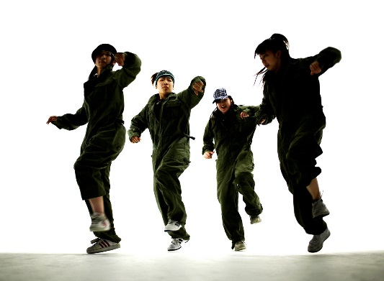
Lesson Objective:
Participate in an effective warm up showing focus, energy and determination.
Rehearse street dance routine
Perform street dance routine

Slide 3
Success Criteria
Level | Dance Strand
 | 1 Creating | 2 Performing | 3 Reflecting
Entry | I can remember a range of actions I can create phrases based on a stimulus or music | I can participate in a short group performance I show some consideration of spatial awareness in performance | I can recognise when my own work and the work of others’, could be improved
1 | I can perform simple dance phrase demonstrating choreographic skills | I can use appropriate characterisation in a performance | I can talk about why I made certain decisions in my choreography I can show a basic understanding of how a stimuli can be conveyed
2 | I can create a choreography using unison and cannon I can learn teacher led sequences and then use these to develop my own levels I can create a choreography using a range of stimuli I can take on feedback to improve my choreography such as using levels and/or contract work I can sustain a focus within a performance | I can learn a routine and take part in simple performances | I can give suggestions on how work could be improved I can talk about my work using some dance terminology I can identify strengths and weaknesses in my own and others work
3 | I can select and apply movement to match the given dance style I can work confidently in a group using a range of choreographic devices to explore different dance styles and ideas I can create and rehearse performance that make use of the range of techniques and dynamics to express my ideas I can give and accept suggestions to/from peers and teachers during the rehearsal process I can learn and create dances in a variety of styles | I experiment with different actions to create a performance I can create routines that are appropriate to the given style or stimuli I can experiment with different styles/actions and dynamics when developing a routine I improve and refine my performance through the rehearsal process I can choreograph a short performance for an audience I can perform a variety of different dance styles | I can reflect on and evaluate my own and other pupils’ work, suggesting improvements I can use key words when talking about dances that I have seen or participated in I can discuss the ways that ideas are communicated

Slide 4
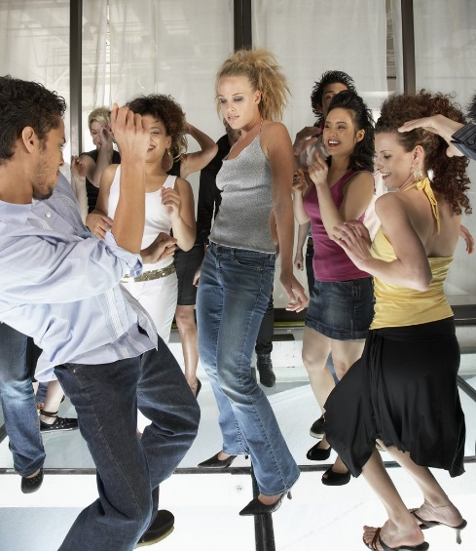
KEY WORDS
FACIAL EXPRESSIONS
MUSICALITY
DYNAMICS
PERFORMANCE
MOVEMENT MEMORY

Slide 5
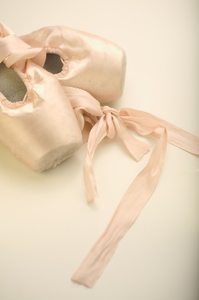
TASKS
WARM UP
RECAP TARGETS
REHEARSE STREET DANCE ROUTINE
EACH GROUP PERFORM AND PEER ASSESS EACH GROUP.

Slide 6
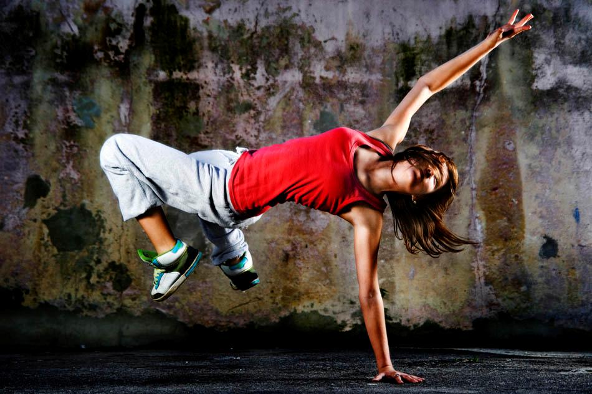
READY, STEADY, PERFORM!!!!!!

Slide 7

PEER ASSESSMENT
WHAT ARE YOU LOOKING FOR?
MUSICALITY
MOVEMENT MEMORY
DYNAMICS
FACIAL EXPRESSIONS

Slide 8
PLENARY
Each corner of the room is a level. Go to the corner you think you are at and be ready to explain why and how you could improve.

